Slide 1
Neural Networks based Automated Test Oracles
Author,
Vulcan Mihai-Aron
Supervisor,
Assoc. Prof. Habil. Vescan Andreea, PhD

Slide 2


Introduction
Notes:
As software systems become increasingly complex and integral to society, delivering high-quality software is paramount. Maintaining and improving software quality throughout its lifecycle involves various processes, with testing being one of the most significant. Unit testing is a common technique used, but as software evolves, functions and methods can become highly complex. Manually selecting tests and calculating outputs for all cases becomes challenging, leading to the "test oracle problem."

Slide 3
Structure
Systematic Literature Review
Study Design :
Models, Metrics, Datasets, Taguchi Analysis
Results of Replication and New Studies
Notes:
This presentation will cover three main topics:
1. A systematic literature review (SLR) on using neural networks for test oracles, including methodology and results.
2. Proposed experiments, detailing models, metrics, datasets, and Taguchi analysis.
3. Results from replication studies and new proposed studies.

Slide 4
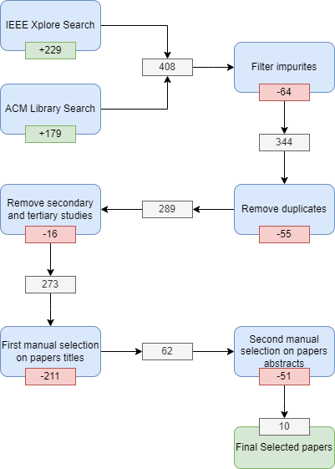
Systematic Literature Review Methodology
Notes:
We conducted an SLR by searching two major databases, IEEE Xplore and the ACM Digital Library, for combinations of neural networks and test oracle terminology. We initially found around 400 articles. After applying a series of filters to remove impurities, duplicates, and irrelevant studies, we narrowed it down to 10 relevant articles. The filtration process included:
- Removing non-research entries such as proceedings and table of contents.
- Eliminating duplicates.
- Filtering secondary and tertiary studies.
- Refining based on titles and abstracts.

Slide 5
Systematic Literature Review Results
Notes:
Data was extracted from the selected papers focusing on:
- **Oracle Type**: Most papers developed test verdict oracles (outputs indicating pass/fail) and simulation oracles (outputs matching system behavior).
**Machine Learning Techniques**: Early research used simple backpropagation algorithms, while later studies used more advanced models like radial basis function networks and multi-layer perceptrons.

Slide 6
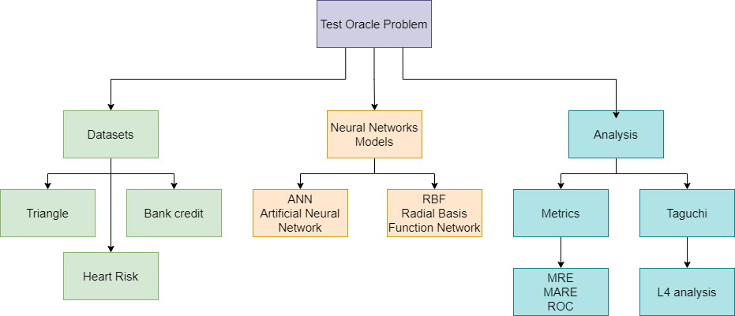
Research Design
Notes:
Our experiments have three dimensions: datasets, models, and analysis.

Slide 7
Datasets
Parameters | Triangle | Bank Credit | Heart Risk
No. Input | 3 | 4 | 6
Output | 4 classes | 4 classes | 4 classes
Size | 800 entries | 800 entries | 800 entries
No. Mutated Functions | N\A | 4 | 4
Mutation Dataset Size | N\A | 891 | 698
Notes:
1. **Triangle Dataset**: Consists of three values representing triangle sides, categorized into four classes. Created similar to other research for replication
2. **Bank Credit Dataset**: Includes inputs like age and salary, outputting maximum credit values split into four classes. We created a mutated version with logical and numerical errors.
3. **Heart Risk Dataset**: Similar to the Bank Credit dataset, with inputs like age and stress level, also mutated for faults.

Slide 8
Neural Network Models
Parameter | ANN | RBF
Input Nodes | 3/4/6 – depends on dataset | 3/4/6 – depends on dataset
Hidden layer size | 24-triangle, 50-other datasets | 200
Output Nodes | 1 | 1
Epochs | 50-triangle, 100-other datasets | 100
Learning Rate | 0.001 | 0.005
Notes:
1. **ANN (Artificial Neural Network)**: Backpropagation neural network with a single hidden layer, sigmoid activation, and Adam optimizer. Learning rate: 0.001.
- Triangle dataset: 25 nodes, 50 epochs.
- Other datasets: 50 nodes, 100 epochs.
2. **RBF (Radial Basis Function Network)**: Single-layer network with Gaussian activation and Adam optimizer. Learning rate: 0.005.
- All datasets: 200 nodes, 100 epochs.

Slide 9
Taguchi L4 Analysis
 | ANN |  | RBF
Parameters | Epochs | Hidden Layer | Epochs | Hidden Layer
1st Experiment | 50 | 25 | 50 | 200
2nd Experiment | 50 | 50 | 50 | 350
3rd Experiment | 100 | 25 | 100 | 200
4th Experiment | 100 | 50 | 100 | 350

Slide 10
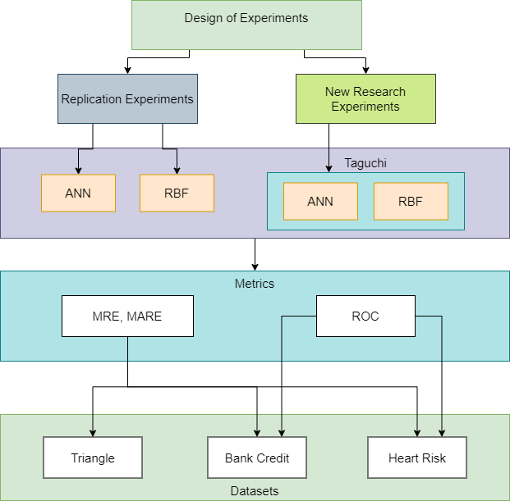
Design of Experiments

Slide 11
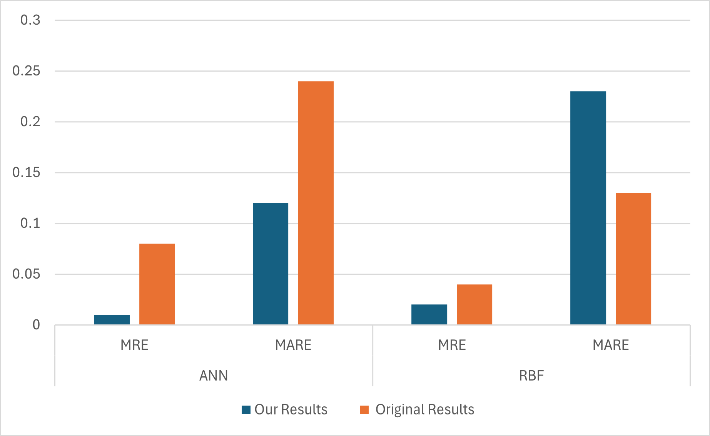
Comparison with other research Results on Triangle Dataset
Notes:
### Comparison
Comparing our results on the Triangle dataset with existing research, our ANN model shows better mean relative error, but other studies have better RBF performance. Notably, dataset differences and the use of PyTorch versus MATLAB impact results.

Slide 12
Replication Study Results + New Studies
 | ANN |  | RBF
Parameters | MRE | MARE | MRE | MARE
Triangle Dataset | 0.01 | 0.12 | 0.02 | 0.23
Bank Credit Dataset | -0.1 | 0.23 | -0.02 | 0.09
Heart Risk Dataset | -0.07 | 0.19 | -0.05 | 0.12
Notes:
### Replication Study Results
Our replication study shows promising results, particularly with mean relative error, indicating no significant bias in our models. The RBF model generally outperforms the ANN model, except for the Triangle dataset.

Slide 13
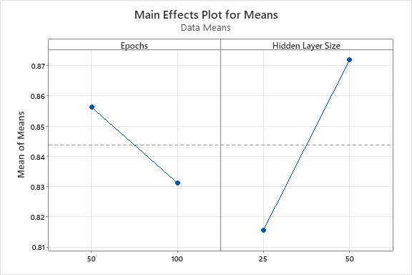
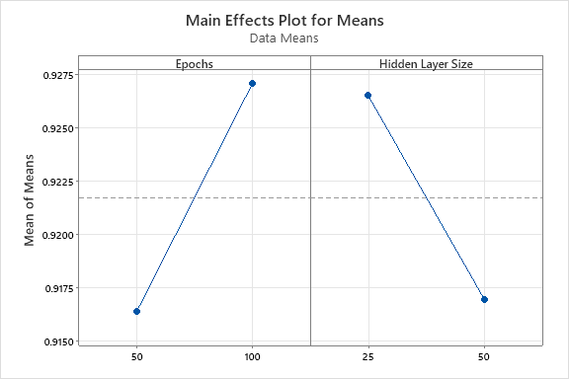
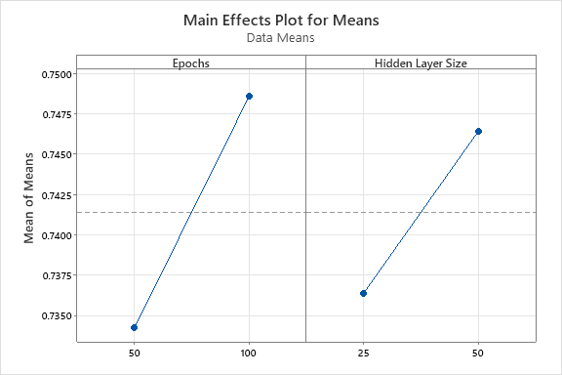
Taguchi L4 Analysis Results For ANN
Triangle Dataset
Bank Credit Dataset
Heart Risk Dataset
Notes:
hyperparameter optimization
Performance varies with the number of epochs and hidden layer nodes depending on the dataset. For example, fewer epochs work better for the Triangle dataset, while more epochs are better for others.

Slide 14
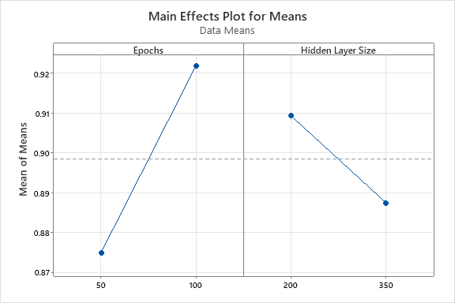
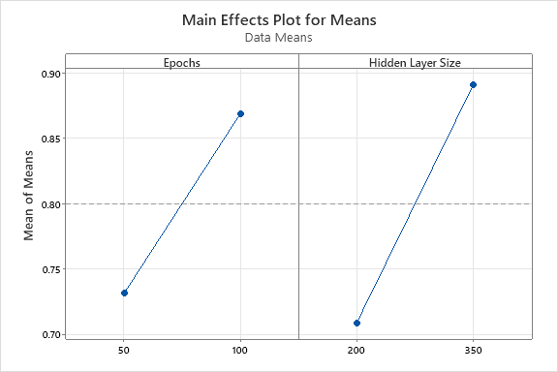
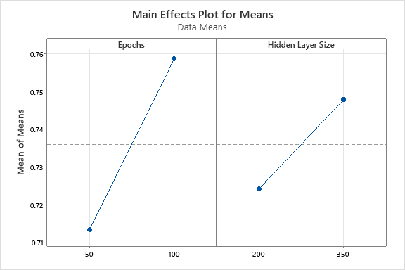
Taguchi L4 Analysis Results For RBF
Triangle Dataset
Bank Credit Dataset
Heart Risk Dataset
Notes:
#### RBF Model
- More epochs consistently yield better performance across datasets, with more nodes performing better for complex datasets.

Slide 15


Outline Test Oracle Literature Review Neural Networks Results of Experiments
Conclusions & Future work
Novelty
Experiments
The results are sent for dissemination to the Journal Neural Networks (rank A) as an article and it is under review.
Test Oracle Solution based on Neural Networks Dataset generation
ANN vs. RBF Neural Networks
Various ANN architectures
Three Generated Datasets
Vulcan Mihai-Aron, Andreea Vescan
Neural Networks based Automated Test Oracles
Notes:
### Conclusions
Neural networks are effective in addressing the test oracle problem. Future research should explore more complex Taguchi analyses and additional neural network models to further enhance testing efficiency and accuracy.
The results are sent for dissemination to the Journal Neural Networks (rank A) as an article and it is under review.

